Slide 1
Introduction to
International Business Administration

Slide 2
Exports, Imports, and Countertrade
Notes:
This is a test

Slide 3
Prof. Dr. Amit Shah
Notes:
This is a test

Slide 4
Exports, Imports, Countertrade
Opportunities and risks of exporting
Steps to improve export performance
Information sources/programs on exporting
Financing exporting
Countertrade as an export facilitator

Slide 5
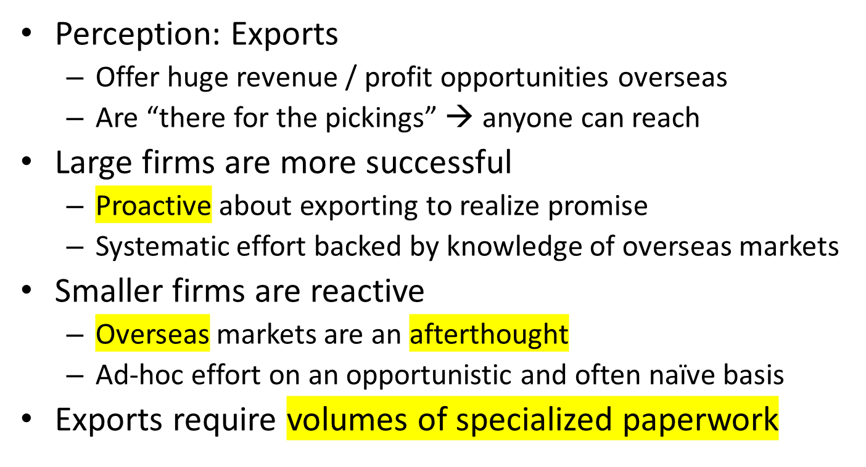
Exporting Opportunities and Risks
Notes:
To expand abroad you need to do a lot of paperwork

Slide 6
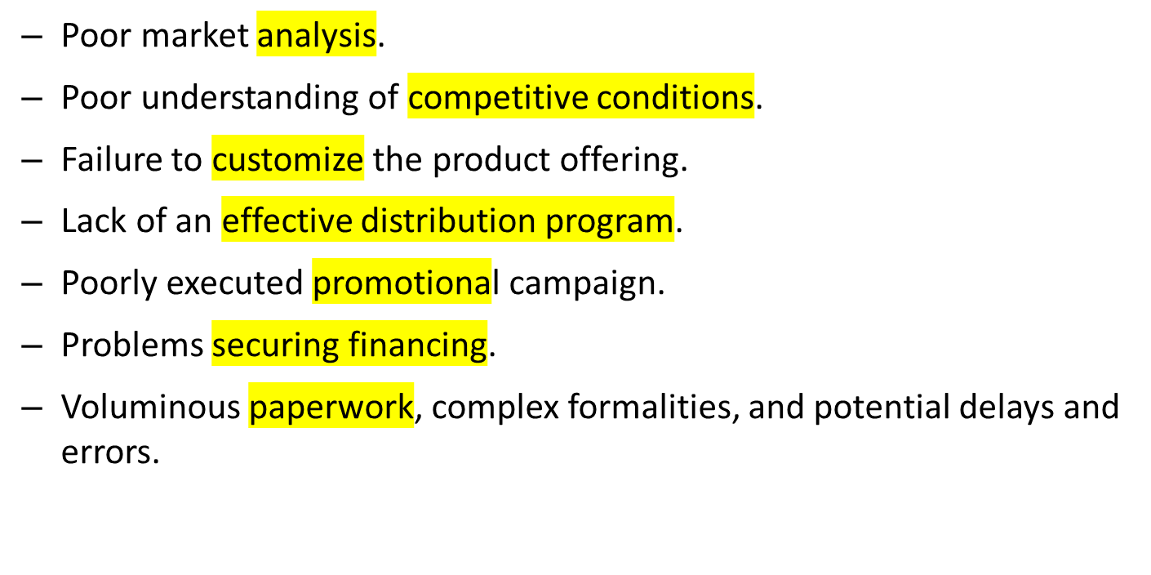
Common Pitfalls for Exporters
Notes:
According to a United Nations report on trade and development, a typical international trade transaction may involve 30 parties, 60 original documents, and 360 document copies, all of which have to be checked, transmitted, reentered into various information systems, processed, and filed. The UN has calculated that the time involved in preparing documentation, along with the costs of common errors in paperwork, often amounts to 10 percent of the final value of goods exported.
Poor market analysis → you don’t know the market
Paperwork → 30 parties and over 60 original documents → adds 10 percent to the price

Slide 7
Export Performance Improvement Factors
Government information sources
  US: various parts of the Dept. of Commerce
  Other countries: similar entity
  Embassies and consulates: commercial sections
Export management companies
  Act as the export department of firms
  Experienced specialists
  Not exclusive
Focused export strategy

Slide 8
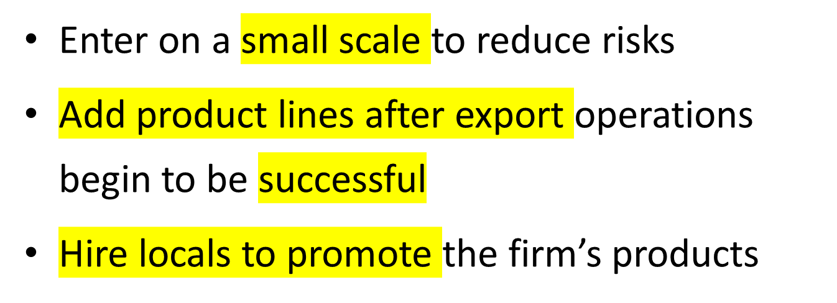
Some Successful Export Strategies

Slide 9
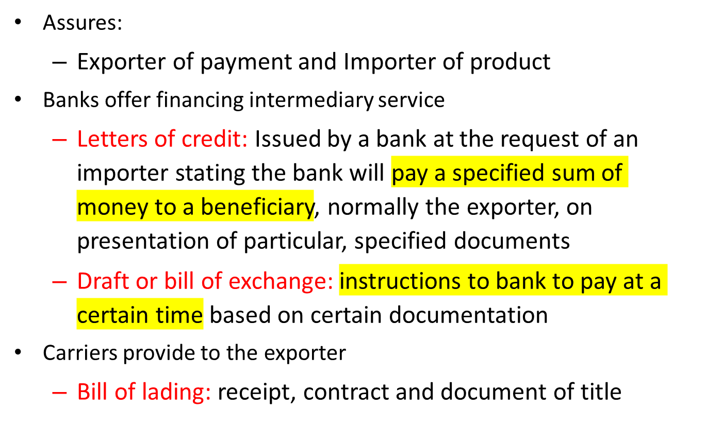
Export/Import Financing
Notes:
Financing makes sure everybody gets what they want
Get a 3rd party involved so that everybody will be happy/nobody has the upper hand
Bank pays the role of the guarantee → if those things are presented, the bank will pay → take the companies out of the picture

Slide 10
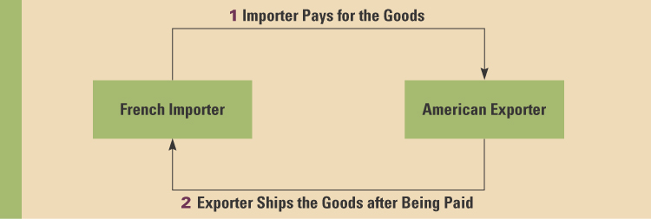
What the American Company Wants

Slide 11
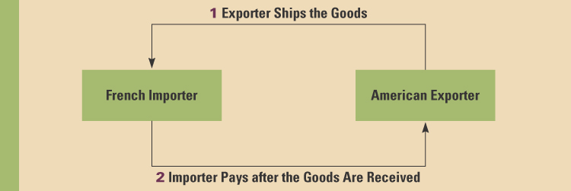
What the French Company Wants

Slide 12
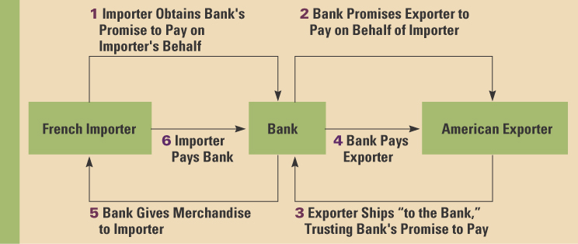
Use of a third party

Slide 13
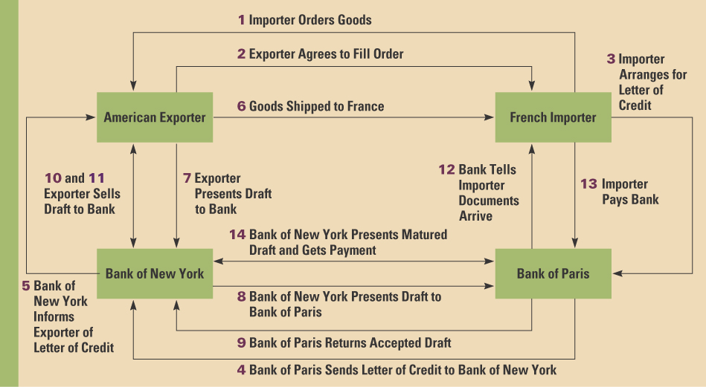
Typical Transaction with 2 Banks

Slide 14
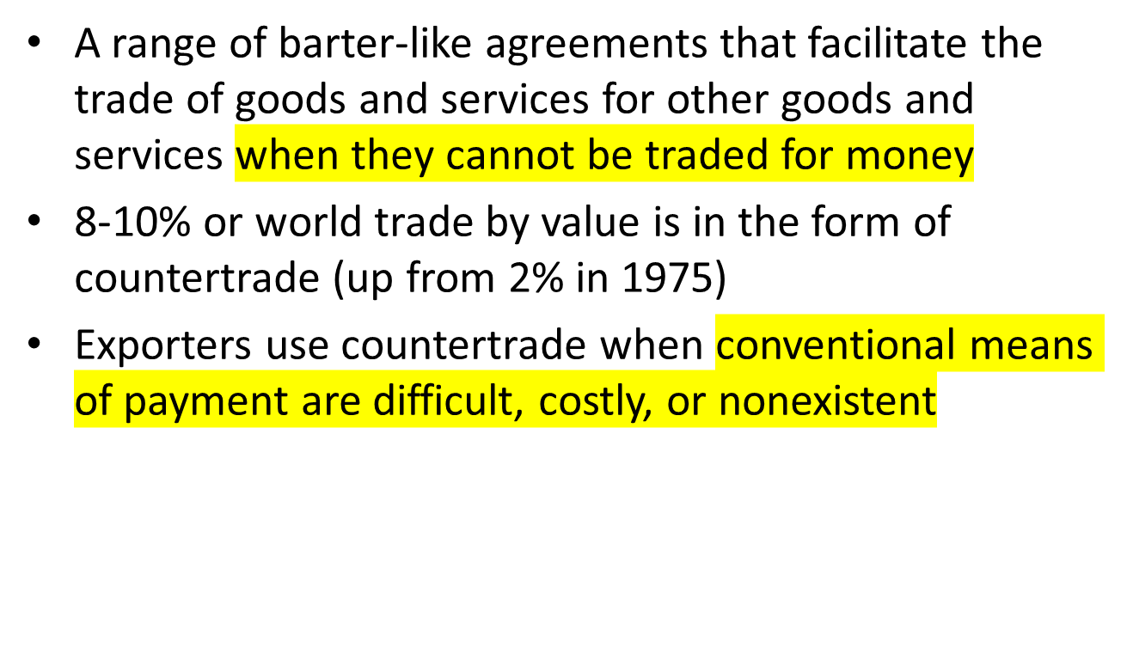
Countertrade
Notes:
Not freely convertible currency → countertrades
If one cannot be paid, they will be countertrading

Slide 15
Countertrade Examples
Philip Morris shipped cigarettes to Russia, for which it received chemicals used to make fertilizer. Philip Morris shipped the chemicals to China, and in return, China shipped glassware to North America for retail sale by Philip Morris.
Iraqi oil for food program in 1990s.
Venezuela provides oil to other countries in exchange for services and arms.
Cuba sends medical people to other countries in exchange for commodities.
Several countries exchange sugar for other commodities and services.

Slide 16
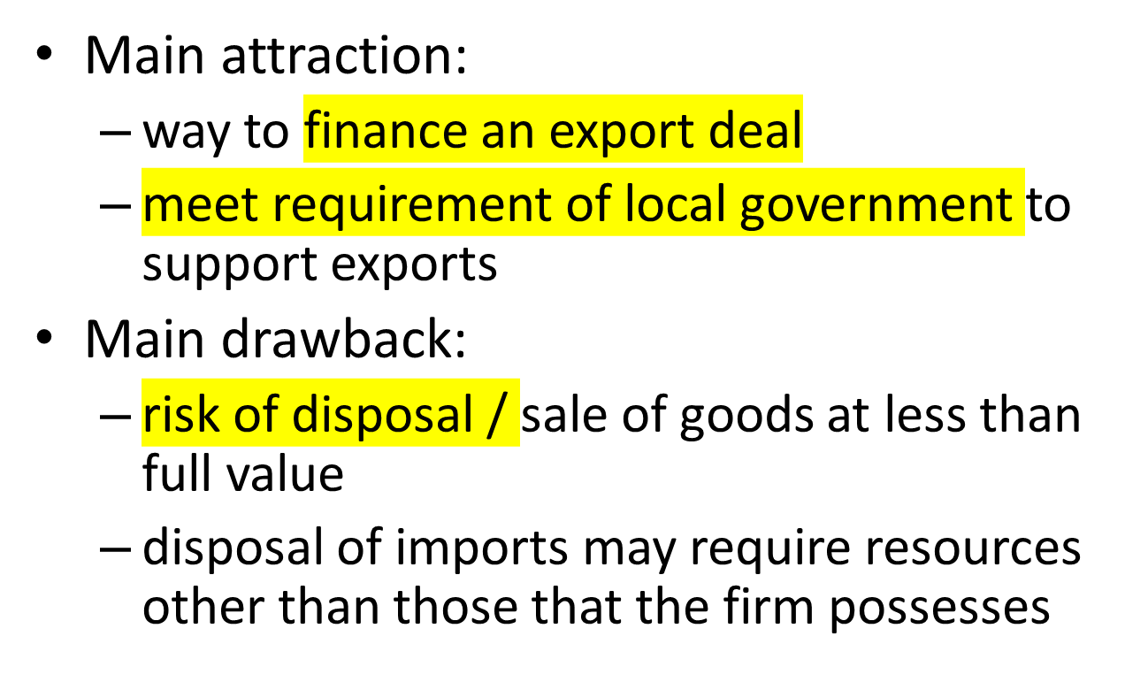
Countertrade
Notes:
Drawback:
You are not sure whether you can actually sell the products you receive for the countertrade and may have to sell them far below market price

Slide 17
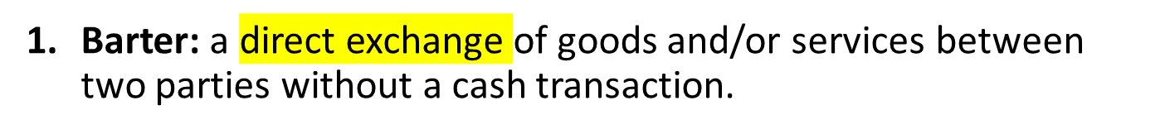
Types of Countertrade
    The most restrictive countertrade arrangement.
    Used primarily for one-time-only deals in transactions with trading partners who are not creditworthy or trustworthy.
Counterpurchase: a reciprocal buying agreement.
Occurs when a firm agrees to purchase a certain amount of materials back from a country to which a sale is made.
I sell you and then i buy from your country again (a certain amount)
Notes:
With its roots in the simple trading of goods and services for other goods and services, countertrade has evolved into a diverse set of activities that can be categorized as five distinct types of trading arrangements: barter, counterpurchase, offset, switch trading, and compensation or buyback.

Slide 18
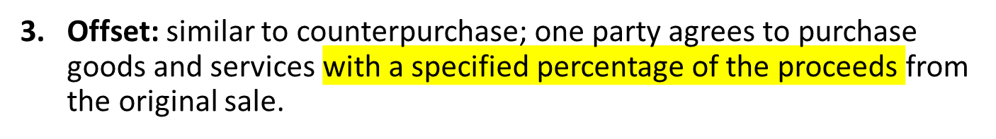
Types of Countertrade (continued)
    This party can fulfill obligation with any firm in the country to which the sale is being made.
  Switch trading: a specialized third-party trading house buys a firm’s counterpurchase credits and sells them to another firm.
  Compensation or buybacks: a firm builds a plant in a country—or supplies technology, equipment, training, or other services to the country—and agrees to take a percentage of the plant’s output as a partial payment for the contract. → a certain amount of production belongs to another company
Notes:
In one example of switch trading, Poland and Greece had a counterpurchase agreement that called for Poland to buy the same U.S.-dollar value of goods from Greece that it sold to Greece. However, Poland could not find enough Greek goods that it required, so it ended up with a dollar-denominated counterpurchase balance in Greece that it was unwilling to use. A switch trader bought the right to 250,000 counterpurchase dollars from Poland for $225,000 and sold them to a European sultana (grape) merchant for $235,000, who used them to purchase sultanas from Greece.

Slide 19
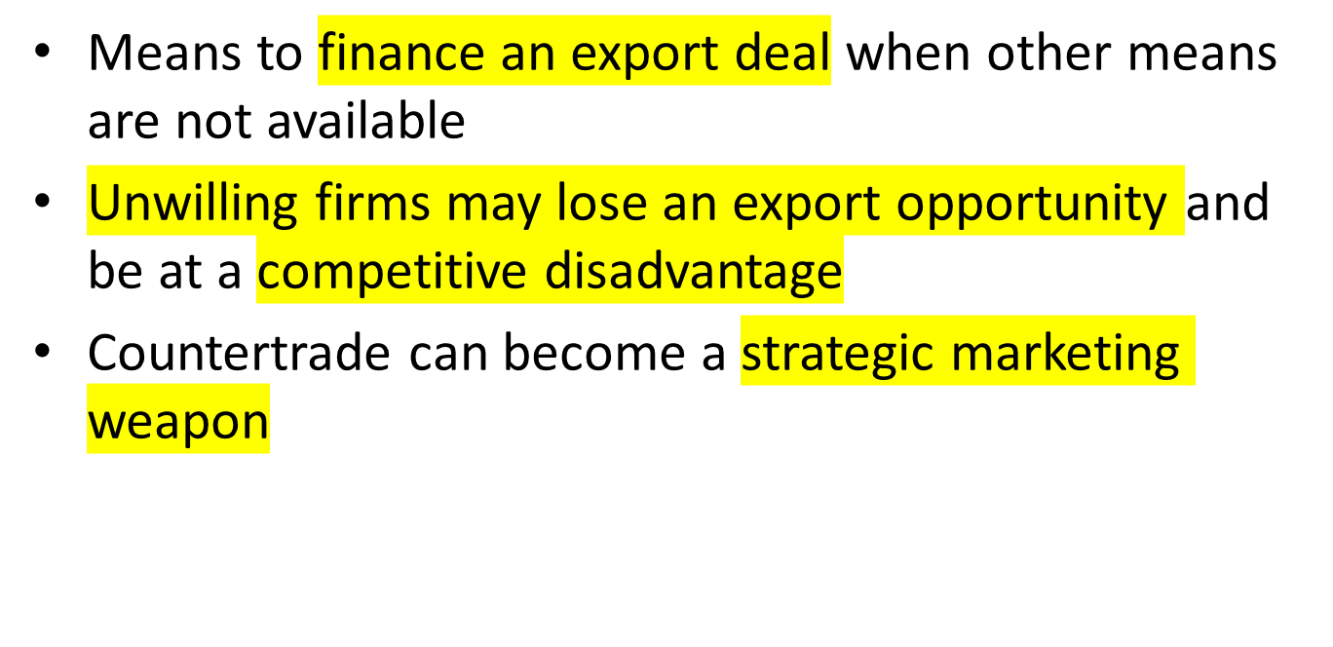
Advantages of Countertrade

Slide 20
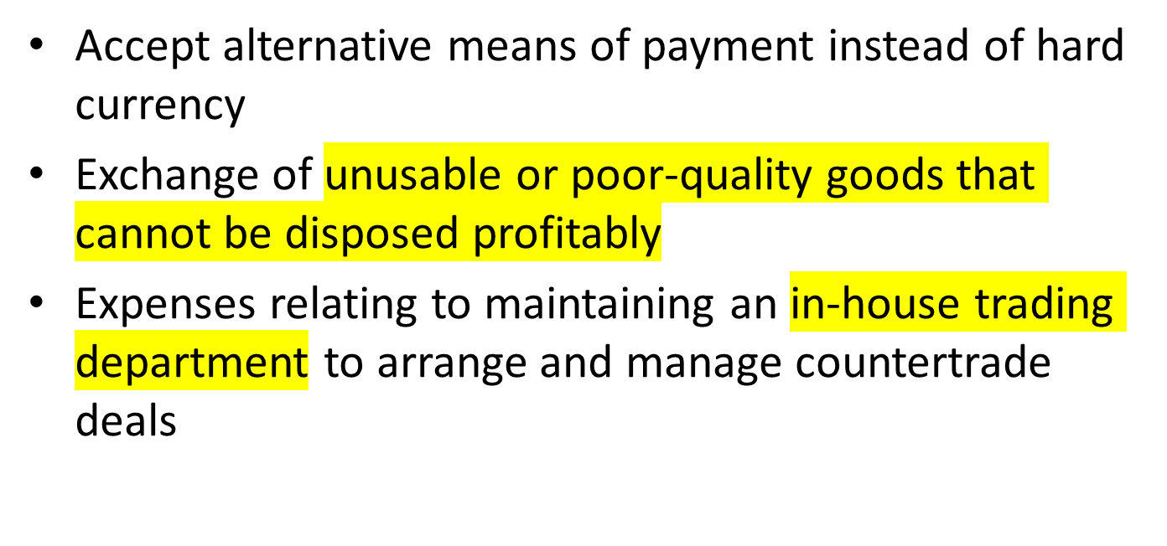
Disadvantages of Countertrade

Slide 21
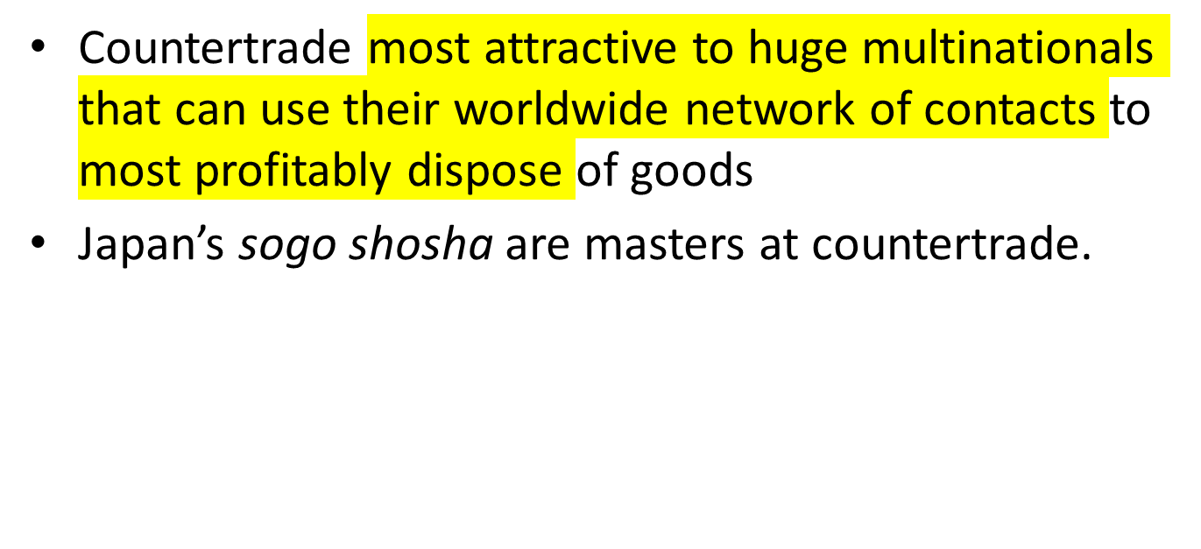
Firm’s Suitability to Countertrade
Notes:
Sogo shosha → large multinational companies that do basically everything (can plug products from countertrades into other areas of production)

Slide 22
End of E-I Lecture

